Slide 1
Collisions on Reduced Rounds of SHA 256
Divjot Singh
(Advisor - Dr Somitra Sanadhya)

Slide 2
Cryptographic Hash Functions (H)
{0, 1}*
H maps arbitrary length input to fixed length output.
SHA-256
{0, 1}²⁵⁶
Collision Resistant Property: Finding any x, x' such that H(x) = H(x') should be inefficient.
Notes:
f takes as input a block and IV. It first expands the message breaks the block into 16 equal parts(called words). And then expands the number of words to 80 using the 16 words.

Slide 3
Previous Results
Reduced Rounds Collisions
Reduced Rounds Semi-Free Start Collisions
Publication and Year | Rounds
[1] Sanadhya, S. K., & Sarkar, P. (2007) | 21
[3] Indesteege, S., Mendel, F., Preneel, B., & Rechberger, C. (2008) | 24
[2] Sanadhya, S. K., & Sarkar, P. (2008) | 24 (Better Complexity)
[4] Mendel, F., Nad, T., & Schläffer, M. (2011) | 27
Publication and Year | Rounds
[3] Indesteege, S., Mendel, F., Preneel, B., & Rechberger, C. (2008) | 24
[4] Mendel, F., Nad, T., & Schläffer, M. (2011) | 28
[5] Mendel F., Nad T., & Schläffer M. (2013) | 38
Notes:
f takes as input a block and IV. It first expands the message breaks the block into 16 equal parts(called words). And then expands the number of words to 80 using the 16 words.

Slide 4
Project Results
Developed tools which help us analyse small components of SHA-256.
Developed a new method to find collisions.
This method was used to produce 22 step collisions.
The best algorithm can find collisions for 27 steps.
Found 23 step semi-free start collisions.
A semi-free start collision is a collision on a relaxed version of SHA-256.
The best algorithm can find collisions for 38 steps.

Slide 5
Next up
Description of SHA-256
Structure of our Collision Attack
Creating Differentials given Additive Difference
Analysis of Σ₀ Function
Future Work

Slide 6
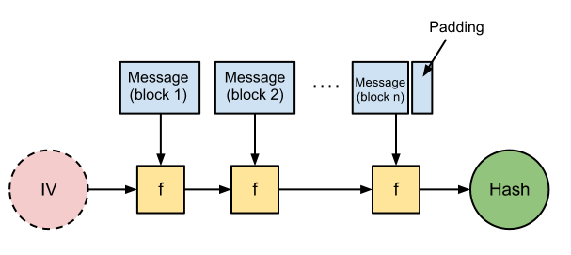
Quick Definition - SHA2
Arbitrary Length Message
Initial State
This structure ensures that to get a collision, it is sufficient to find two initial blocks that produce the same output.
Notes:
f takes as input a block and IV. It first expands the message breaks the block into 16 equal parts(called words). And then expands the number of words to 80 using the 16 words.

Slide 7
Quick Definition - SHA2
i^{th} Message Block
m₀ m₁ m₂ . . . m₁₅
16
w₀ w₁ w₂ . . . w₆₃
64
Notes:
f takes as input a block and IV. It first expands the message breaks the block into 16 equal parts(called words). And then expands the number of words to 80 using the 16 words.

Slide 8
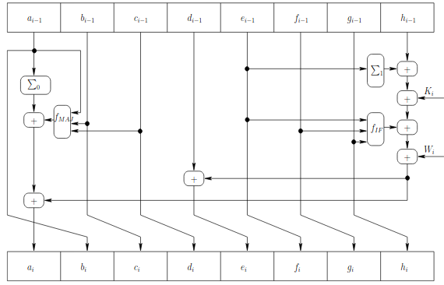
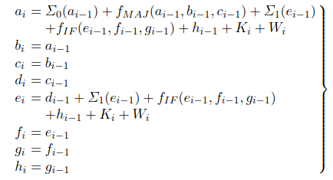
Quick Definition - SHA2
w₀ w₁ w₂ . . . w_{i} w₆₃
Image from [1]
Image from [1]
The output of the block is the state after all the updates.
Only A and E get "new" values in each update.
Notes:
f takes as input a block and IV. It first expands the message breaks the block into 16 equal parts(called words). And then expands the number of words to 80 using the 16 words.

Slide 9
Next up
Description of SHA-256
Structure of our Collision Attack
Creating Differentials given Additive Difference
Analysis of Σ₀ Function
Future Work

Slide 10
Attack Strategy
Creating a differential table
Finding Message Pairs

Slide 11
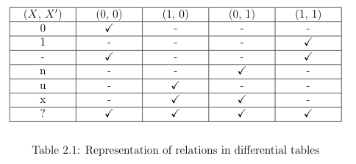
Differential
A differential stores information regarding the corresponding bits of a variable and its counterpart. This is because the eventual goal is to find a pair of messages.
∇A = "un10-" implies that A and A' are two 5 bit variables with certain restrictions given by the table.
Here, A₀ = 1 & A'₀ = 0
….

Slide 12
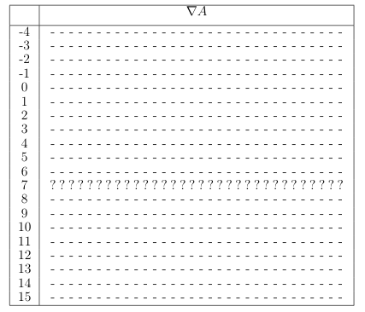
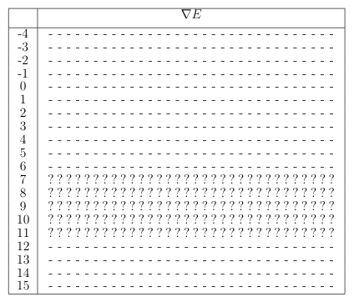
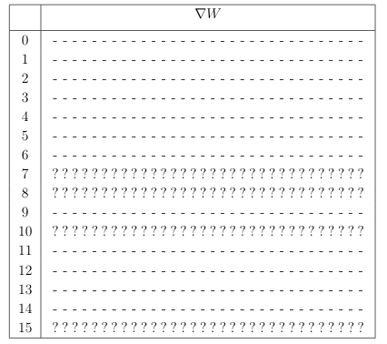
Differential Table
A differential table stores differentials for all variables of the two messages and state variables that produce collisions. Here is the initial table we used:

Slide 13
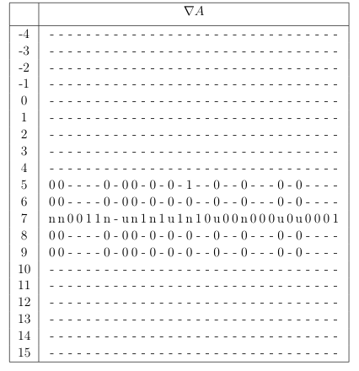
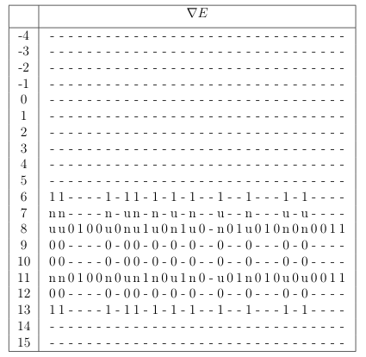
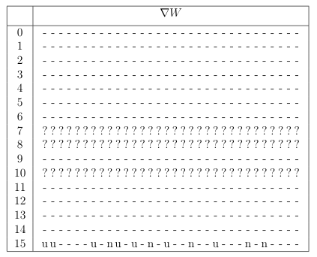
Differential Table
This is one of the final tables we come up with using the previous tables as initial step, and making various adjustments which requires the tools we have developed. The analysis is semi-automatic.

Slide 14
Searching Message Pairs
Using the created differential tables, we use a "randomized" and "smart" DFS to find the message pairs.
Here, "A" is more dense than "E" and "W" has no restrictions. To satisfy such a case, we fix a random value for (A, A') and compute (W, W') that produce these. Then, we compute (E, E') and check whether they follow the differential or not.
We also do not check all possible values at a step if many are possible (since that would take lots of time), we rather have a threshold that increases depending on how deep we are able to go with the current value.

Slide 15
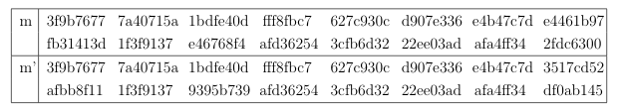
Collision Results
The message pair below produce collisions on 22 steps of SHA-256 (in hex)

Slide 16
Next up
Description of SHA-256
Structure of our Collision Attack
Creating Differentials given Additive Difference
Analysis of Σ₀ Function
Future Work

Slide 17
Creating Differentials Given Difference
Finding solutions for x, x' such that
x' - x = Δ
Observation : If "un---u-----n---u" is a solution for ∇x, then so is
"un---nu----n---u"
"un---nnu---n---u"
"un---nnu---un--u"…and so on..
This happens because the contribution of 'n' at ∇x_{i} in x' - x is 2^{i}
And that of 'u' is -2^{i}.
Hence, if we can come up with one differential, we can come up up with lots of differentials.

Slide 18
Creating Differentials Given Difference
Finding solutions for x, x' such that
x' - x = Δ
One valid ∇x can be obtained by representing Δ in binary and setting ∇x_{i} = 'n' if Δ_{i} = 1 and '-' otherwise. Example:
Δ = 10 and x, x' ∈ {0, 1}⁶
∇x = "-n-n--"
Applying the strategy in the last slide, we can obtain 6 differentials for ∇x

Slide 19
Next up
Description of SHA-256
Structure of our Collision Attack
Creating Differentials given Additive Difference
Analysis of Σ₀ Function
Future Work

Slide 20
Analyzing Σ₀
Σ₀(A) = A >>> 2 ⊕ A >>> 13 ⊕ A >>> 22
XOR of three bits of input determine one bit of output
Given a x-differential for A, an x-differential for Σ₀(A) can be obtained.
If an odd number of causing bits is 'x', then
the caused bit is 'x' and otherwise it is '-'
x-differential only contains 'x' and '-' bits.
A = "- - u - - .. n - - .. n - - u"
Σ₀(A) = " - - - - .. n - .. u - - u - -"
'u' means that(A', A) = (0, 1).
Let the causing bits be 'u', 'u', '-'. Therefore, the caused bit in:
Σ₀(A') will be 0 ⊕ 0 ⊕ a = a
Σ₀(A) will be 1 ⊕ 1 ⊕ a = a
Similar analysis can be done for different possibilities of causing bits

Slide 21
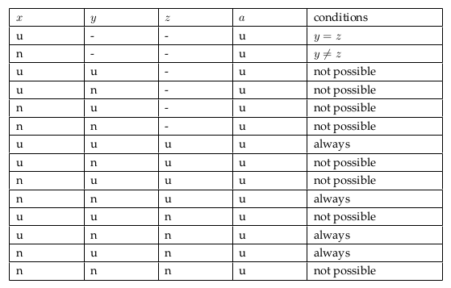
Analyzing Σ₀
Σ₀(A) = A >>> 2 ⊕ A >>> 13 ⊕ A >>> 22
XOR of three bits of input determine one bit of output
Let x, y, z be the causing bits of a, then we can generate a table of conditions.
'u' means that(A', A) = (0, 1).
Let the causing bits be 'u', '-', '-'. Therefore, the caused bit in:
Σ₀(A') will be 0 ⊕ b ⊕ a = 0 ⊕ r
Σ₀(A) will be 1 ⊕ b ⊕ a = 1 ⊕ r
If the caused bit is desired to be 'u' then we add the condition a = b,
And if the caused bit is desired to be 'n' then we add the condition a != b

Slide 22
Analyzing Σ₀
Finding solutions for x, x' such that
Σ₀(x') - Σ₀(x) = Δ₀
x' - x = Δ₁
Algorithm :
Fix a random differential for x using the difference in x variable. This fixes x-differential for Σ₀(x)
Check if we can set bits of x-differential of Σ₀(x) such that the difference is Δ₀ (this check uses the table we created in the last slide - we can check the conditions by solving 2 SAT)
Since it is not always possible to find a solution, this algorithm is run for some threshold number of times.

Slide 23
Result of Experiments
The experiment:
Set random values of Δ₀ and Δ₁
Check if the conditions are satisfied (threshold set to 1000). If true, return number of iterations, else increment iterations and go back to step 1.
Σ(x') - Σ(x) = Δ₀
x' - x = Δ₁
Function | Iterations
Σ₀ | 31732
Σ₁ | 27246
σ₀ | 10
σ₁ | 19358

Slide 24
Next up
Description of SHA-256
Structure of our Collision Attack
Creating Differentials given Additive Difference
Analysis of Σ₀ Function
Future Work

Slide 25
Future Work
Incorporate more differentials for a fixed additive difference.
Better methods for message search given differentials.
Fully automatic creation of differentials. Right now, the method is semi-automatic since it requires manual analysis initially.
Getting collisions on more number of rounds.

Slide 26
References
Sanadhya, S. K., & Sarkar, P. (2007). New local collisions for the SHA-2 hash family. , 4817, 193–205.
Sanadhya, S. K., & Sarkar, P. (2008). New collision attacks against up to 24-step sha-2. Cryptology ePrint Archive, Report 2008/270.
Indesteege, S., Mendel, F., Preneel, B., & Rechberger, C. (2008). Collisions and other non-random properties for step-reduced sha-256. Cryptology ePrint Archive, Report 2008/131.
Mendel, F., Nad, T., & Schläffer, M. (2011). Finding sha-2 characteristics: Searching through a minefield of contradictions. , 288–307.
Mendel F., Nad T., & Schläffer M. (2013) Improving Local Collisions: New Attacks on Reduced SHA-256. In: Johansson T., Nguyen P.Q. (eds) Advances in Cryptology – EUROCRYPT 2013.

Slide 27
Thank You!

